Slide 1



ANNUAL SALARY REVIEW MILESTONE PROJECT
This Photo by Unknown Author is licensed under CC BY-NC-ND
GUIDED BY :
RAMYA M
PRINESH ROUT
DA & DS AUGUST B BATCH

Slide 2
PROJECT OVERVIEW
The goal of this project is to systematically assess and analyze employee compensation data across the organization for the current review period. It aims to ensure equitable pay practices, identify salary trends, flag disparities, and provide actionable insights to support HR and leadership in decision-making for salary adjustments, promotions, and budget planning.
GOALS
Evaluate employee salaries relative to their performance ratings so that high performers are recognized with appropriate increases or rewards, and salary adjustments are justified by performance data.
Use SQL and Excel analytics to discover trends, patterns, and anomalies in compensation data (such as significant pay gaps or inconsistencies), enabling data-driven decisions.

Slide 3
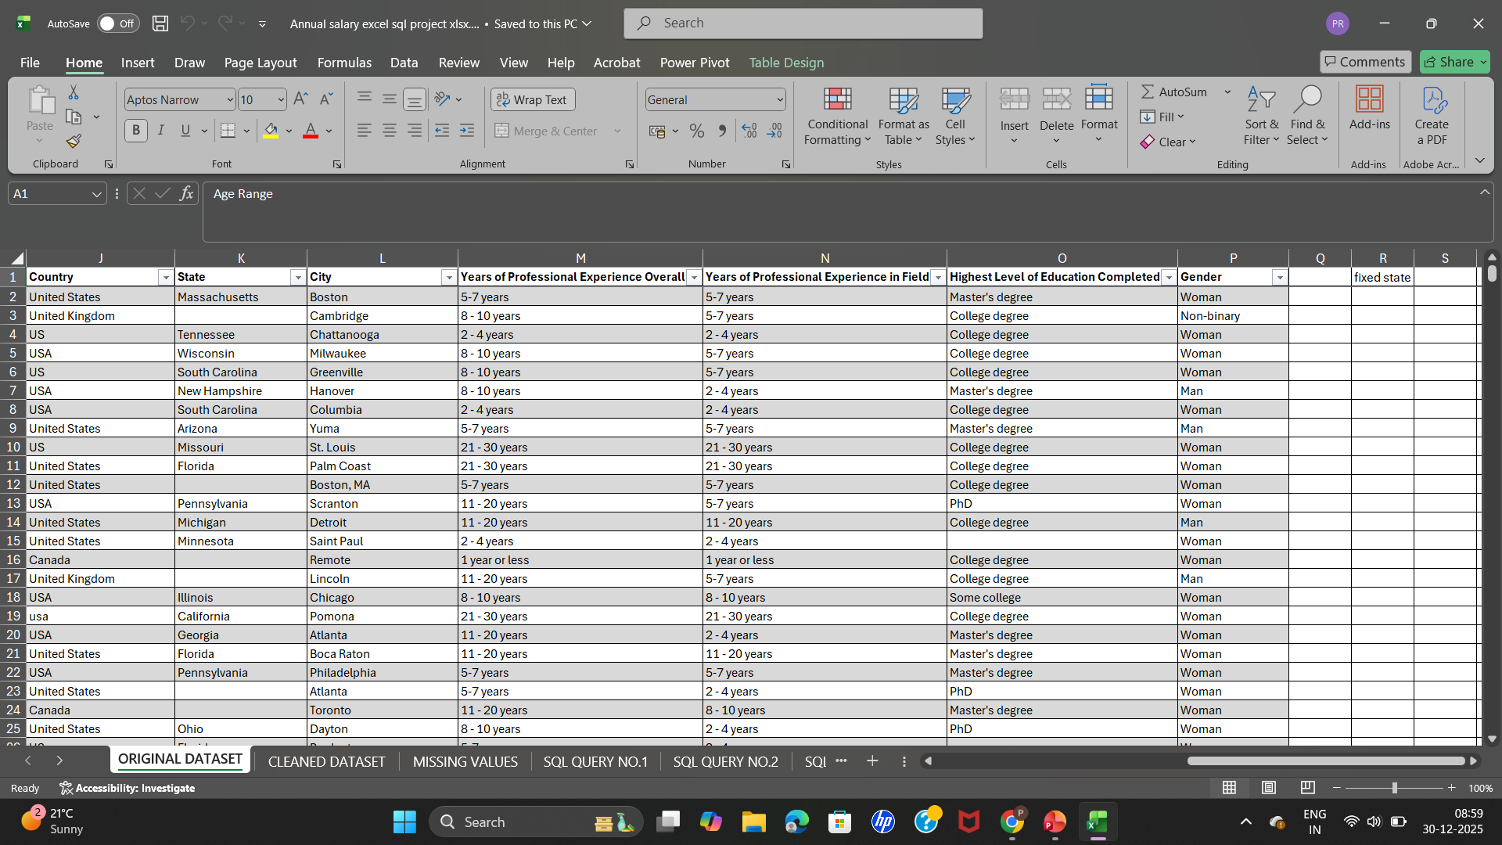
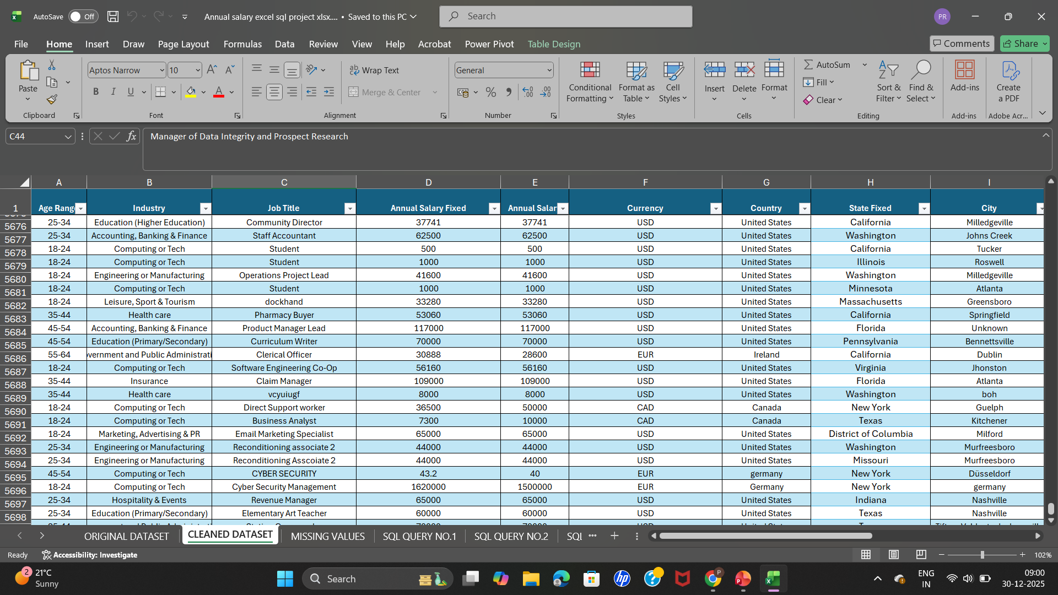
DATA DESCRIPTIONS & PREPROCESSING
The original dataset contains 27,546 rows & 16 columns .
The important metrics are Job Title ,Gender ,industry , annual salary ,currency ,country , additional monetary compensations.
Imported datasets into MS EXCEL for preprocessing & analysis.
Verified data consistency across uniform format & applied data validations.
Original Dataset
Cleaned Dataset

Slide 4
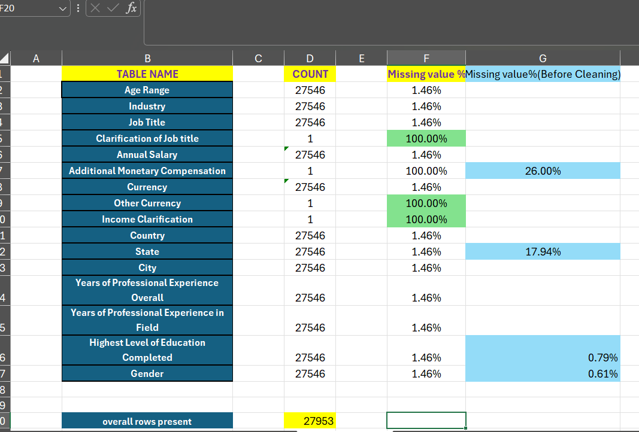
Handling Missing Values
Handling missing values means identifying and either removing or filling in gaps in the dataset so the data is complete and reliable for analysis.

Slide 5
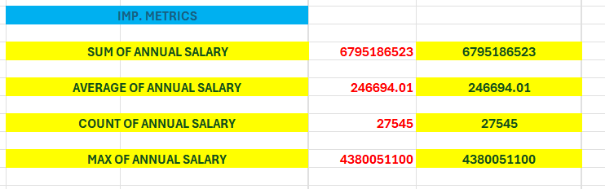
KEY METRICS CALCULATIONS & DATA ANALYSIS
Sum of annual salary=SUM(Fixed annual salary)
Average of annual salary=AVG(Fixed annual salary)
Count of annual salary=Count(Fixed annual salary)
Maximum annual salary=Maximum(Fixed annual salary)

Slide 6
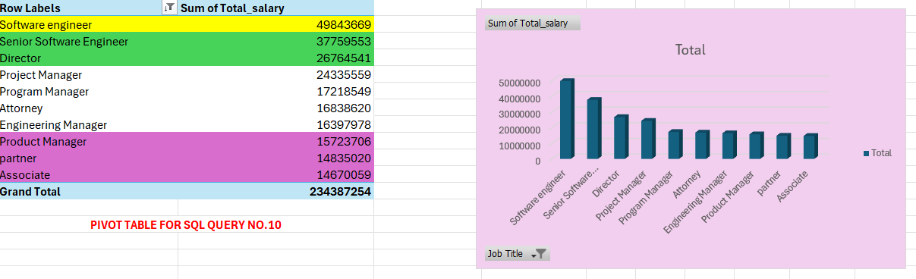
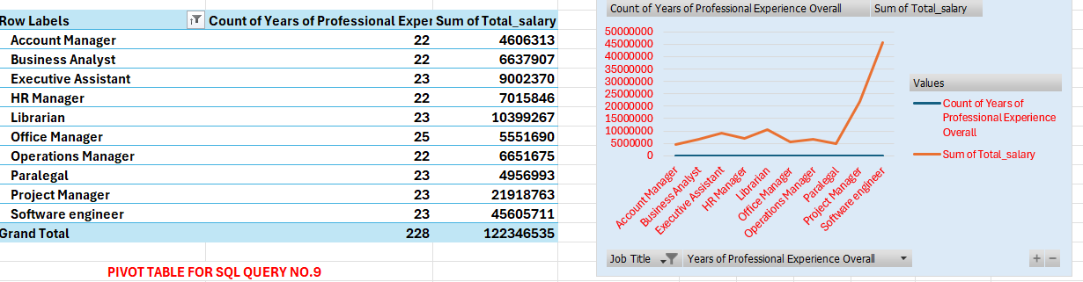
PIVOT TABLES & PIVOT CHARTS
A Pivot Table is used to summarize ,analyze , explore & to present large amounts of data into an easy-to-understand & interactive way.

Slide 7
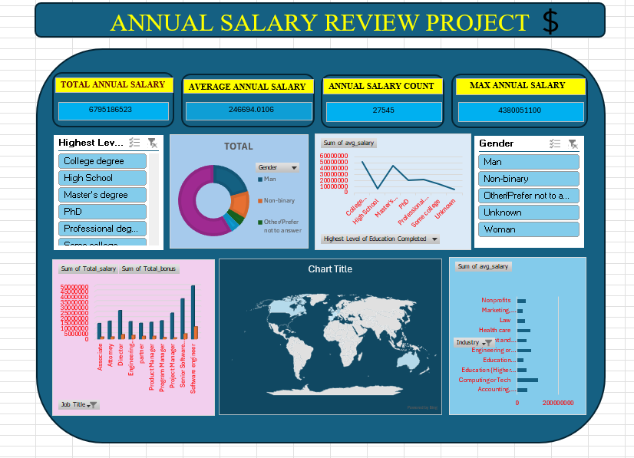
DASHBOARD OVERVIEW

Slide 8
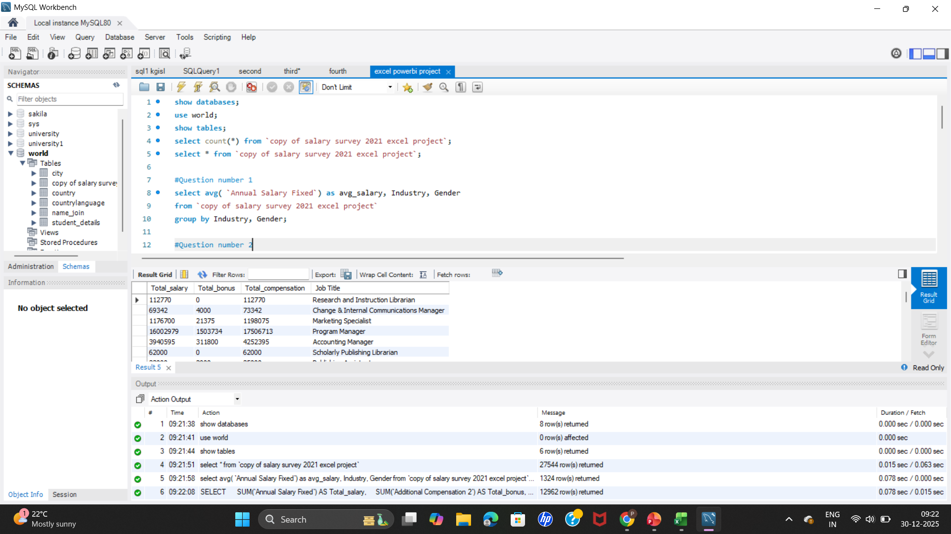
SQL QUERY
SQL queries are structured commands written in Structured Query Language to retrieve, filter, and manipulate employee compensation data from the database.

Slide 9
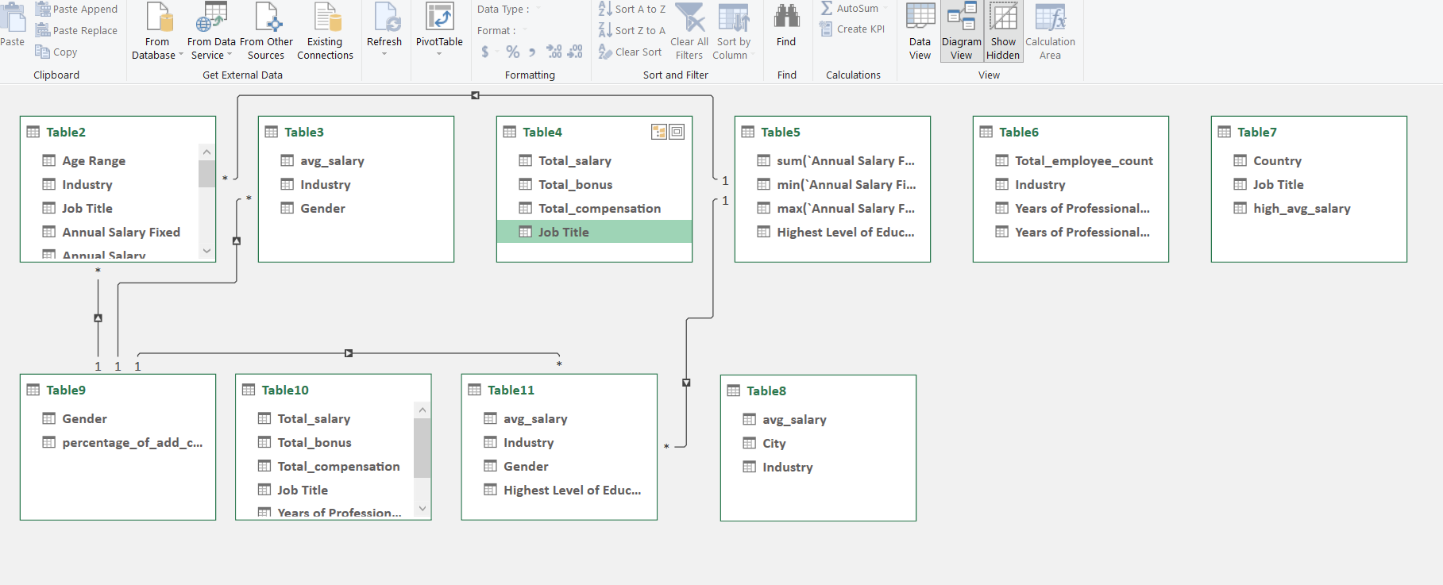
Power Query
Power Query is a data-import and transformation tool in Excel that lets you connect to multiple data sources, clean and reshape data, and load it into worksheets for analysis.

Slide 10
RESEARCHED INSIGHTS
United States ,Germany& UK are the top paying countries contributing 10m $,1.5m$ &1.7m$ resp.
Software engineers & Senior software engineers earns the highest salary & highest add. Compensation .
Employees having non-IT job title earns less salary although having higher experience in resp . field.
Women earns more than the men in respective domains.
Engineering , manufacturing &computer techs have highest average salary I . E 6.7k$ &4.6k$.
Employees having highest academic degrees(PhD , MD , Masters degree) has lower avg. salary as their no. is comparatively low than employees having basic academic degrees.
Average salary of men is lower than women but when it comes to bonus & add. Compensation men earns more than women.
Employees having Associate & manager job title earns less bonus.
Europe employees earns less add. Compensation & salary than other regions.
Marketing , advertising & PR earns least salary & bonus I . e 2.8k $.

Slide 11
RECOMMENDATION
Employees having Software engineer & senior Software engineer job title should apply for USA & UK as they’re paying more salaries comparable to others.
First Compare salary & compensation across countries(US , Germany ,UK , Europe etc.) then apply for the respective countries.
It’s shown that experience pays fairness so add. Compensation & bonus increased with employees having resp. job titles.
If Employees having men as gender work extra shift they can get better bonus & compensation than other genders.
Salary analysis shows that IT peoples earns more than Non-IT peoples so , it’s advice for peoples having Non-Tech domain job title to upskill for an IT roles as it pays more.
Employees having highest salary & compensations belongs from highest academic degree backgrounds(PhD, MD, Masters )so, it’s highly urged employees having basic academic degrees to upskill.
Australia pays more than some of the Europe countries so, it’s a suggestion for employees having Asian or Indo-pacific regions to target Australia for jobs.
Role & education impact on Salary benchmarking.

